Slide 1
Budapest Convention on Cybercrime
Vineet Rao 161070001
Vinayak Borhade 161070004
Ameya Daddikar 161070015
Rishabh Bansal 161070035

Slide 2
Small Case Studies to Press need for CyberCrime Regulations

Slide 3
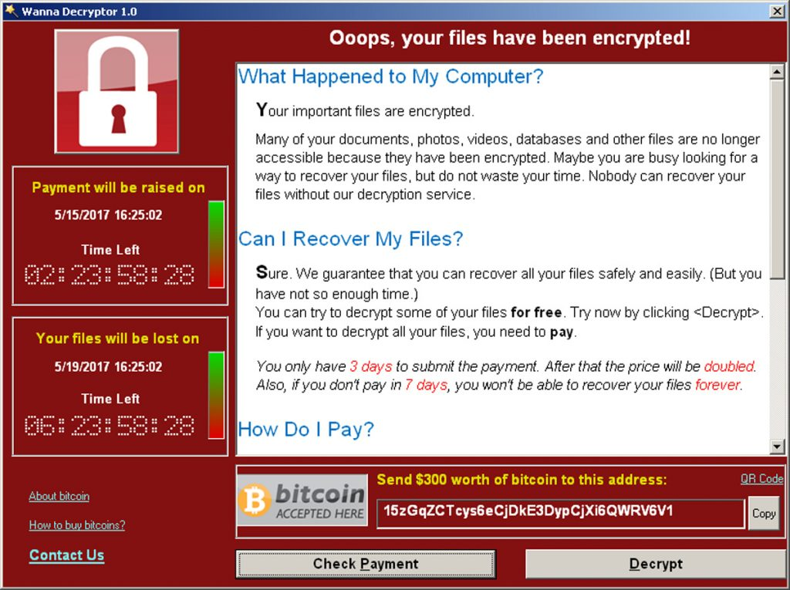
WannaCry virus hits the NHS, 2017
The most widespread cyber attack ever, hackers managed to gain access to the NHS' computer system in mid-2017, causes chaos among the UK's medical system.
exploit of Windows' Server Message Block (SMB) protocol
Ransomware affectionately named "WannaCry" was delivered via email in the form of an attachment.
As many as 300,000 computers were infected with the virus.
Notes:
Once a user clicked on the attachment, the virus was spread through their computer, locking up all of their files and demanding money before they could be accessed again.

Slide 4

JP and Morgan Chase & Co target of giant hacking conglomerate, 2015
Late in 2015, three men were charged with stealing data from millions of people
“one of the largest thefts of financial-related data in history”.
Thought to have been operating out of Israel, the trio targeted major corporations
manipulate stock prices and make enormous financial gain.
Notes:
The group stole information from more than 83 million customers from JP Morgan alone, and are thought to have made hundred of millions of dollars in illegal profits.
Illegal bitcoin exchange, and the laundering of money through approximately 75 shell companies and accounts globally.

Slide 5
Sony Pictures crippled by GOP hackers, 2014
In late 2014, major entertainment company Sony Pictures were hit with a crippling virus.
Cyber crime group Guardians of Peace (GOP) were behind the apparent blackmail attempt, which saw around 100 terabytes of sensitive data stolen from the company.
It is largely thought that the attack was related to North Korea's disapproval of the film 'The Interview', which humorously predicted Kim Jong-un and contained a plot where main characters attempted to assassinate the head of state.
US government agencies investigated the claim that North Korea had authorised the cyber attack in an attempt to prevent the film from being released.

Slide 6
One billion user accounts stolen from Yahoo, 2013
In one of the largest cases of data theft in history, Yahoo had information from more than one billion user accounts stolen in 2013.
Personal information including names, phone numbers, passwords and email addresses were taken from the internet giant.
Yahoo claimed at the time that no bank details were taken.

Slide 7
Norway Bank robbery Case study
In the beginning of 2005, a Norwegian citizen attacked a bank in Oslo.
Some days later, police discovered that A.T. was the owner of an email account from a provider in the United Kingdom.
One day, A.T. used his email account to send an email message.
It was found that it came from Spain.
British and Spanish authorities installed an alert system
Later, A.T. began to use his email account from a cybercafé.
A.T. was extradited to Norway and prosecuted.
Notes:
He intended to steal money and he did so effectively. During his action, a police officer was killed. A.T. ran away and could not be found in Norway
International co-operation was required from British authorities which asked the provider to put his email account under surveillance.
It is clear from the above that although the crime occurred in Norway, a lot of work was actually done by the authorities in the United Kingdom and Spain. In a serious case such as this where there was a bank robbery as well as a murder involved, the amount of effort expended by authorities from other states may be appropriate but it is unlikely that the authorities in Britain and Spain would have allocated such resources for a petty crime.
After some days of surveillance, British police announced that A.T. was online, using his email account, and provided the IP address. Very rapidly, the Spanish ISP informed Spanish police from the concrete location of the cybercafé what allowed the officers in the street to identify and arrest A.T. in place.
All the connexions were made from cybercafés in Madrid. Even proceeding to that area very quickly, during a long period of time it was not possible to arrive at those places before A.T. was gone
In the United Kingdom, police asked the ISP information about the IP address where the communication came from
Thus, each time A.T. used his account, British police obtained the IP address of the computer in the origin of the communication and provided it immediately to Spanish police
Then, Spanish police asked the Spanish ISPs about the owner or user of the IP address.

Slide 8
BUDAPEST CONVENTION
4 Chapters
48 Articles

Slide 9
BUDAPEST CONVENTION
International Treaty
Cyber crimes
Seeks International Cooperation
What is it ?

Slide 10
SCOPE OF THE BUDAPEST CONVENTION
01
Criminal Offenses to be established under domestic law
Substantial Criminal Law
02
Six procedural powers to be established under domestic law
Procedural Law
03
Extradition, cooperation in investigation
Rules on International Cooperation

Slide 11
CHAPTER 1 :: DEFINITIONS
01
Any device or a group of interconnected or related devices, one or more of which, pursuant to a program, performs automatic processing of data;
Computer System
02
Any representation of facts, information or concepts in a form suitable for processing in a computer system, including a program suitable to cause a computer system to perform a function
Computer Data
03
Public/private entity that provides to users of its service the ability to communicate by means of a computer system
Any other entity that processes or stores computer data on behalf
Service Provider
04
any computer data relating to a communication by means of a computer system, generated by a computer system that formed a part in the chain of communication,
Traffic Data

Slide 12
BUDAPEST CONVENTION
Council of Europe
Committee of Ministers
64 states
Who drew it ?

Slide 13
BUDAPEST CONVENTION
Copyright Infringements
Internet Fraud
Hate Crimes
Child Assault
Deals with..

Slide 14
BUDAPEST CONVENTION
Illegal Access
Illegal Interception
Data Interference
System Interference
Misuse of Devices
Article 2 - 10
Section 1 (Offenses)

Slide 15
BUDAPEST CONVENTION
Aiding / Abetting attempt
Corporate Liability
Sanctions & Measures
Article 11 - 12 - 13
Section 1

Slide 16
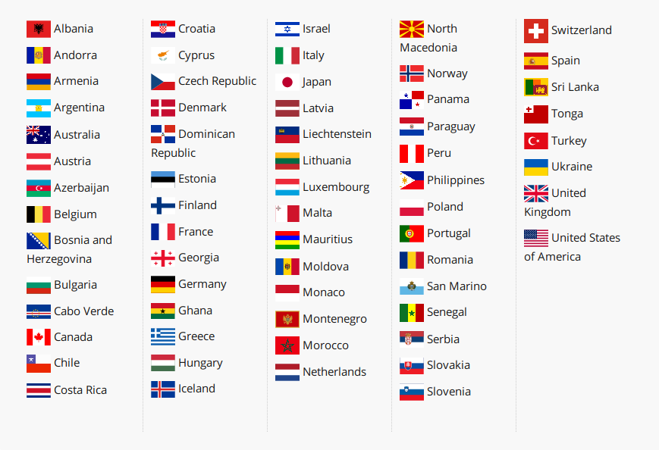
PARTIES TO THE CONVENTION

Slide 17
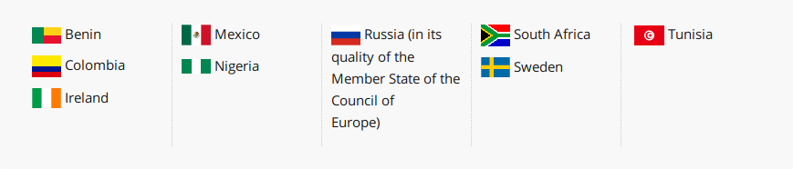
OBSERVERS TO THE CONVENTION

Slide 18
OBSERVER ORGANIZATIONS
African Union Commission (AUC)
Commonwealth Secretariat
European Union (European Commission and Council of the European Union, Eurojust, Europol, European Network and Information Security Agency (ENISA))
G7 High-Tech Crime Subgroup
International Telecommunication Union (ITU)
Interpol
Organisation for Economic Cooperation and Development (OECD)
Organisation for Security and Co-operation in Europe (OSCE)
Organisation of American States (OAS)
Southeast European Law Enforcement Center (SELEC)
United Nations Office on Drugs and Crime (UNODC)

Slide 19
ADDITIONS TO THE CONVENTION

Slide 20
ADDITIONAL PROTOCOL TO THE CONVENTION ON CYBERCRIME
Criminalizes dissemination of racist and xenophobic material over computer systems
Also covers related threats and insults
Prevents denial of Holocaust and other internationally accepted genocides
Opened on 28 January 2003 and entry into force is 1 March 2006
29 have ratified and 13 have signed

Slide 21
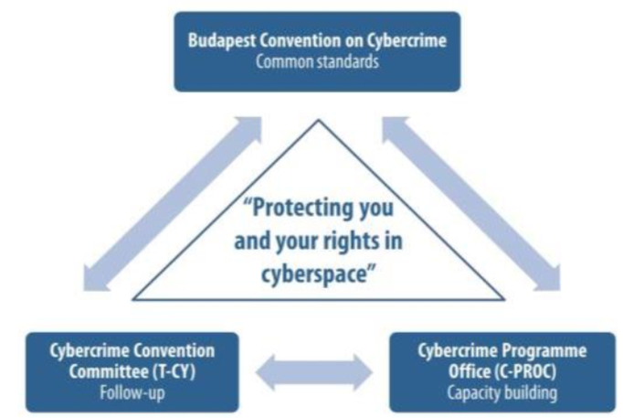
Budapest Convention issues common standards for signatory nations to follow
The quality of implementation is assessed by the Cybercrime Convention Committee (T-CY) representing the Parties to the Budapest Convention
States committed to cooperate under this Convention are furthermore supported through capacity building projects managed by a dedicated Cybercrime Programme Office of the Council of Europe (C-PROC) in Romania

Slide 22
INDIA AND THE BUDAPEST CONVENTION

Slide 23
NON-MEMBERS
Many countries are not members of the convention
Some major countries outside the convention include
India
Russia
Brazil
Major reasons include data access security, privacy concerns, and sovereignty concerns.

Slide 24
HISTORY OF INDIA’S LAWS
India originally legislated on cybercrime with Information Technology Act, 2000.
In brief, this provided for recognition of digital methods of transmission, authorization (like digital signatures), and setting up of bodies related to handling cybercrime.
By 2008, India and the Council of Europe cooperated to introduce various changes in the IT Act.
Thus, India’s legislation was brought broadly in line with the convention.

Slide 25
INDIA’S CONCERNS
The convention was drafted with a number of developed countries, but without much input from developing countries.
Terrorism is not addressed at all in the convention. This is despite the fact that terrorism over cyberspace is one of the most pressing issues for India.
Transborder access to data is a concern shared by many other countries, primarily Brazil and Russia. It is believed to violate sovereignty, due to the provisions of Article 32. Foreign access to data also ties in with privacy concerns

Slide 26
CONCERNS - CONT’D
Lack of human rights concerns - the convention simply uses Article 15, and a mention in other articles and guidelines. India pushed for better human rights guidelines in May 2015, at the 18th session of CSTD
Copyright protection is extensive in many countries, but not so much in India. The extent of protections provided in the convention reflects this. Similar issues have been raised by Brazil.
Staticness and effectiveness have been an issue. Even the Council of Europe has considered the issue of effectiveness.

Slide 27
CONCERNS - CONT’D
Promise of cooperation is not firm enough; states can refuse on a number of issues
Criminal justice treaty and not covering state actors
Instead of joining the convention, a UN level agreement might be more favourable, and India may pursue it

Slide 28
CURRENT STATUS
There are advantages to joining the convention
India would likely get an international platform to discuss future reforms to cyber laws
India could become a primary country for capacity building
Considering the push to digital India, and the increase in cyber crime, the decision to not join is being rethought
In 2018, the Ministry of Home Affairs flagged the advantages and need of joining the convention
However, the IB opposes this move on data privacy and individual human rights.

Slide 29
REFERENCES
https://www.europarl.europa.eu/meetdocs/2014_2019/documents/libe/dv/7_conv_budapest_/7_conv_budapest_en.pdf
https://en.wikipedia.org/wiki/Convention_on_Cybercrime
http://conventions.coe.int/Treaty/EN/Treaties/Html/185.htm
https://www.orfonline.org/expert-speak/india-and-the-budapest-convention-why-not/
https://internetdemocracy.in/reports/india-and-the-budapest-convention-to-sign-or-not-considerations-for-indian-stakeholders/#fnref:13
https://indianexpress.com/article/india/home-ministry-pitches-for-budapest-convention-on-cyber-security-rajnath-singh-5029314/
https://www.coe.int/en/web/cybercrime/parties-observers
https://cis-india.org/internet-governance/blog/vipul-kharbanda-april-29-2019-international-cooperation-in-cybercrime-the-budapest-convention

Slide 30
REFERENCES
https://www.thesun.co.uk/tech/4120942/five-of-the-worst-cases-of-cyber-crime-the-world-has-ever-seen-from-data-theft-of-one-billion-yahoo-users-to-crippling-the-nhs/
https://cis-india.org/internet-governance/blog/vipul-kharbanda-april-29-2019-international-cooperation-in-cybercrime-the-budapest-convention

